Slide 1
Communication

Slide 2
Fundamentals
In a distributed system, processes run on different machines.
Processes can only exchange information through message passing.
harder to program than shared memory communication
Successful distributed systems depend on communication models that hide or simplify message passing

Slide 3
Overview
Message-Passing Protocols
OSI reference model
TCP/IP
Others (Ethernet, token ring, …)
Higher level communication models
Remote Procedure Call (RPC)
Message-Oriented Middleware (time permitting)
Data Streaming (time permitting)

Slide 4
Introduction
A communication network provides data exchange between two or more end points.
Ex: telegraph or telephone system.
In a computer network, the end points of the data exchange are computers and/or terminals. nodes, sites, hosts, etc.,
Networks can use switched, broadcast, or multicast technology

Slide 5
Network Communication Technologies – Switched Networks
Usual approach in wide-area networks
Partially, instead of fully connected
Messages are switched from one segment to another to reach a destination.
Routing is the process of choosing the next segment.
X
Y

Slide 6
Circuit Switching vs Packet Switching
Circuit switching is connection-oriented traditional telephone system
Establish a dedicated path between hosts
Data can flow continuously over the connection
Packet switching divides messages into fixed size units (packets) which are routed through the network individually.
different packets in the same message may follow different routes.

Slide 7
Pros and Cons
Advantages of packet switching:
Requires little or no state information
Failures in the network aren't as troublesome
Multiple messages share a single link
Advantages of circuit switching:
Fast, once the circuit is established
Packet switching is the method of choice since it makes better use of bandwidth.

Slide 8
A Compromise
Virtual circuits: based on packet-switched networks, but allow users to establish a connection usually static between two nodes and then communicate via a stream of bits, much as in true circuit switching
Slower than actual circuit switching because it operates on a shared medium
Layer 4 (using TCP over IP) versus Layer 2/3 virtual circuits (more secure, not necessarily faster or more efficient)

Slide 9
Other Technologies
Broadcast: send message to all computers on the network (primarily a LAN technology)
Multicast: send message to a group of computers
Broadcast
Multicast – shared
Links for efficiency

Slide 10
LANs and WANS
A LAN (Local Area Network) spans a small area – one floor of a building to several buildings
WANs (Wide Area Networks) cover a wider area, connect LANS
LANs are faster and more reliable than WANs, but there is a limit to how many nodes can be connected, how far data can be transmitted.
Notes:
WAN, LAN, MAN, PAN = a network used for communication between devices on or near a person’s body – phone to computer, for example, or medical devices to a monitor. VPN = overlay on e.g., the Internet to provide a more secure private network for an organization to access remote sites. Virtual circuits connect nodes in the overlay

Slide 11
LAN Communication
Most often based on Ethernet
Basic: broadcast messages over a shared medium
Corporations sometimes use Token Ring technology
Simpler communication than over a wide-area network
Faster, more reliable.

Slide 12
Protocols
A protocol is a set of rules that defines how two entities interact.
For example: HTTP, FTP, TCP/IP,
Layered protocols have a hierarchical organization
Conceptually, layer n on one host talks directly to layer n on the other host, but in fact the data must pass through all layers on both machines.

Slide 13
Open Systems Interconnection Reference Model (OSI)
Identifies/describes the issues involved in low-level message exchanges
Divides issues into 7 levels, or layers, from most concrete to most abstract
Each layer provides an interface (set of operations) to the layer immediately above
Supports communication between open systems
Defines functionality – not specific protocols

Slide 14
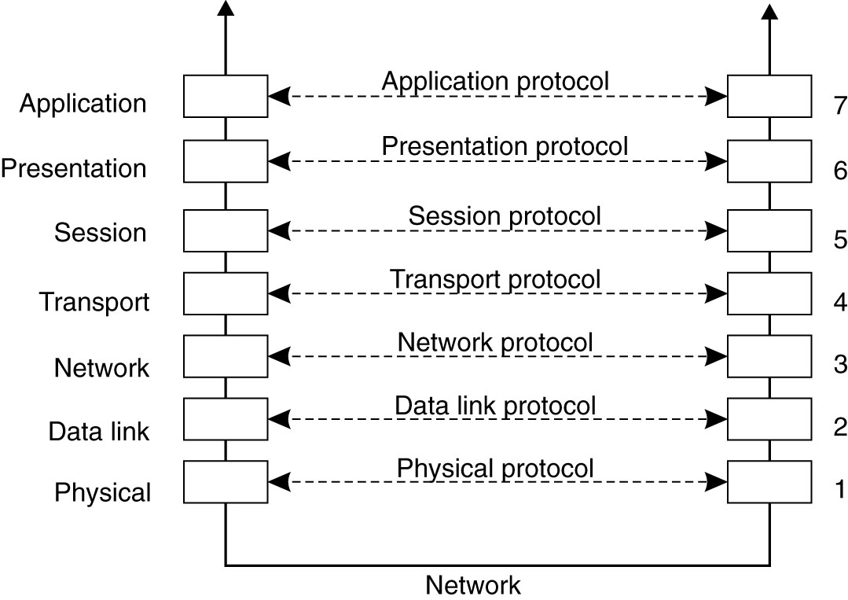
Layered Protocols (1)
High level 7→
Create message, 6 → string of bits
Establish Comm. 5→
Create packets 4→
Network routing 3→
Add header/footer tag + checksum 2→
Transmit bits via 1→ comm. medium (e.g. Copper, Fiber, wireless)
Figure 4-1. Layers, interfaces, and protocols in the OSI model.

Slide 15
Lower-level Protocols
Physical: standardizes electrical, mechanical, and signaling interfaces; e.g.,
# of volts that signal 0 and 1 bits
# of bits/sec transmitted
Plug size and shape, # of pins, etc.
Data Link: provides low-level error checking
Appends start/stop bits to a frame
Computes and checks checksums
Network: routing (generally based on IP)
IP packets need no setup
Each packet in a message is routed independently of the others
Notes:
The data link layer adds a checksum on the sender side and verifies it on the receiver side to determine whether the frame is correct or needs to be retransmitted.

Slide 16
Transport Protocols
Transport layer, sender side: Receives message from higher layers, divides into packets, assigns sequence #
Reliable transport (connection-oriented) can be built on top of connection-oriented or connectionless networks
When a connectionless network is used the transport layer re-assembles messages in order at the receiving end.
Most common transport protocols: TCP/IP

Slide 17
TCP/IP Protocols
Developed originally for Army research network ARPANET.
Major protocol suite for the Internet
Can identify 4 layers, although the design was not developed in a layered manner:
Application (FTP, HTTP, etc.)
Transport: TCP & UDP
IP: routing across multiple networks (IP)
Network interface: network specific details

Slide 18
Reliable/Unreliable Communication
TCP guarantees reliable transmission even if packets are lost or delayed.
Packets must be acknowledged by the receiver– if ACK not received in a certain time period, resend.
Reliable communication is considered connection-oriented because it “looks like” communication in circuit switched networks. One way to implement virtual circuits
Other virtual circuit implementations at layers 2 & 3: ATM, X.25, Frame Relay, ..

Slide 19
Reliable/Unreliable Communication
For applications that value speed over absolute correctness, TCP/IP provides a connectionless protocol: UDP
UDP = Universal Datagram Protocol
Client-server applications may use TCP for reliability, but the overhead is greater
Alternative: let applications provide reliability (end-to-end argument).

Slide 20
Higher Level Protocols
Session layer: rarely supported
Provides dialog control;
Keeps track of who is transmitting
Presentation: also not generally used
Cares about the meaning of the data
Record format, encoding schemes, mediates between different internal representations
Application: Originally meant to be a set of basic services; now holds applications and protocols that don’t fit elsewhere

Slide 21
Middleware Protocols
Tanenbaum proposes a model that distinguishes between application programs, application-specific protocols, and general-purpose protocols
Claim: there are general purpose protocols which are not application specific and not transport protocols; many can be classified as middleware protocols

Slide 22
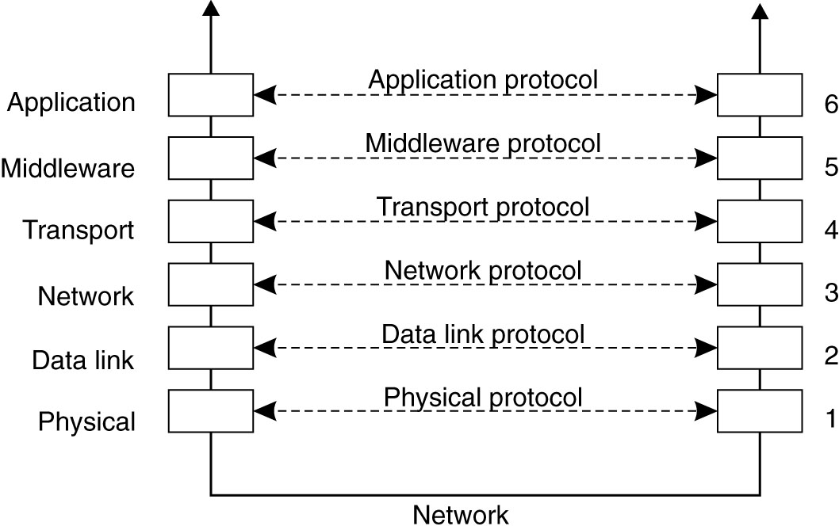
Middleware Protocols
Figure 4-3. An adapted reference model for networked communication.
Notes:
Collapses session and presentation layers into a single layer

Slide 23
Protocols to Support Services
Authentication protocols, to prove identity
Authorization protocols, to grant resource access to authorized users
Distributed commit protocols, used to allow a group of processes to decided to commit or abort a transaction (ensure atomicity) or in fault tolerant applications.
Locking protocols to ensure mutual exclusion on a shared resource in a distributed environment.

Slide 24
Middleware Protocols to Support Communication
Protocols for remote procedure call (RPC) or remote method invocation (RMI)
Protocols to support message-oriented services
Protocols to support streaming real-time data, as for multimedia applications
Protocols to support reliable multicast service across a wide-area network These protocols would be built on top of low-level message passing, as supported by the transport layer.

Slide 25
Messages
Transport layer message passing consists of two types of primitives: send and receive
May be implemented in the OS or through add-on libraries
Messages are composed in user space and sent via a send() primitive.
When processes are expecting a message they execute a receive() primitive.
Receives are often blocking

Slide 26
Types of Communication
Persistent versus transient
Synchronous versus asynchronous
Discrete versus streaming

Slide 27
Persistent versus Transient Communication
Persistent: messages are held by the middleware comm. service until they can be delivered. (Think email)
Sender can terminate after executing send
Receiver will get message next time it runs
Transient: Messages exist only while the sender and receiver are running
Communication errors or inactive receiver cause the message to be discarded.
Transport-level communication is transient
Notes:
If the router can’t forward the message it will drop it.

Slide 28
Asynchronous v Synchronous Communication
Asynchronous: (non-blocking) sender resumes execution as soon as the message is passed to the communication/middleware software
Message is buffered temporarily by the middleware until sent/received
Synchronous: sender is blocked until
The OS or middleware notifies acceptance of the message, or
The message has been delivered to the receiver, or
The receiver processes it & returns a response. (Also called a rendezvous) –this is what we’ve been calling synchronous up until now.

Slide 29
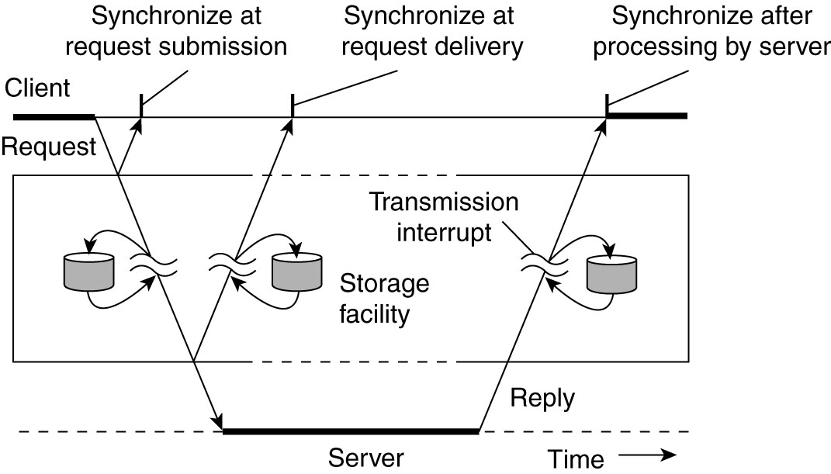
Figure 4-4. Viewing middleware as an intermediate (distributed) service in application-level communication.

Slide 30
Evaluation
Communiction primitives that don’t wait for a response are faster, more flexible, but programs may behave unpredictably since messages will arrive at unpredictable times.
Event-based systems
Fully synchronous primitives may slow processes down, but program behavior is easier to understand.
In multithreaded processes, blocking is not as big a problem because a special thread can be created to wait for messages.

Slide 31
Discrete versus Streaming Communication
Discrete: communicating parties exchange discrete messages
Streaming: one-way communication; a “session” consists of multiple messages from the sender that are related either by send order, temporal proximity, etc.

Slide 32
Middleware Communication Techniques
Remote Procedure Call
Message-Oriented Communication
Stream-Oriented Communication
Multicast Communication

Slide 33
RPC - Motivation
Low level message passing is based on send and receive primitives.
Messages lack access transparency.
Differences in data representation, need to understand message-passing process, etc.
Programming is simplified if processes can exchange information using techniques that are similar to those used in a shared memory environment.
Notes:
Access transparency: differences in data representation and resource access methods is hidden

Slide 34
The Remote Procedure Call (RPC) Model
A high-level network communication interface
Based on the single-process procedure call model.
Client request: formulated as a procedure call to a function on the server.
Server’s reply: formulated as function return

Slide 35
Conventional Procedure Calls
Initiated when a process calls a function or procedure
The caller is “suspended” until the called function completes.
Arguments & return address are pushed onto the process stack.
Variables local to the called function are pushed on the stack

Slide 36
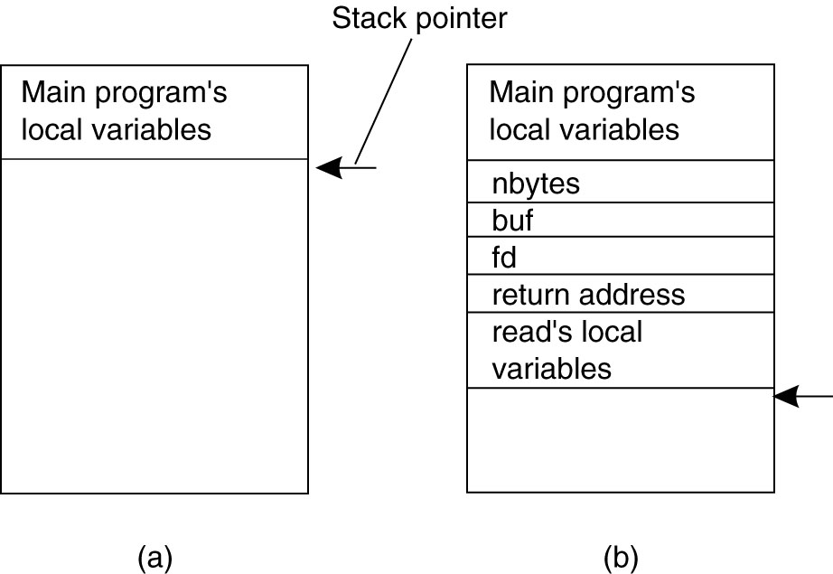
Conventional Procedure Call
count = read(fd, buf, nbytes);
Figure 4-5. (a) Parameter passing in a local procedure call: the stack before the call to read. (b) The stack while the called procedure is active.

Slide 37
Conventional Procedure Calls
Control passes to the called function
The called function executes, returns value(s) either through parameters or in registers.
The stack is popped.
Calling function resumes executing

Slide 38
Remote Procedure Calls
Basic operation of RPC parallels same-process procedure calling
Caller process executes the remote call and is suspended until called function completes and results are returned.
Parameters are passed to the machine where the procedure will execute.
When procedure completes, results are passed back to the caller and the client process resumes execution at that time.

Slide 39
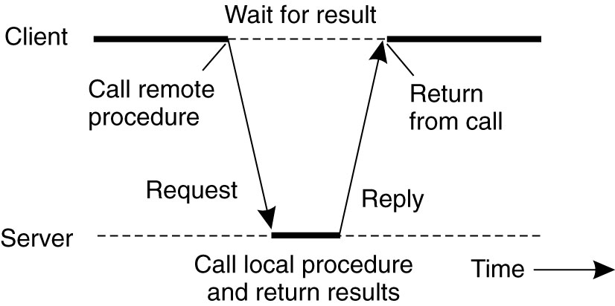
Figure 4-6. Principle of RPC between a client and server program.

Slide 40
RPC and Client-Server
RPC forms the basis of most client-server systems.
Clients formulate requests to servers as procedure calls
Access transparency is provided by the RPC mechanism
Implementation?

Slide 41
Transparency Using Stubs
Stub procedures (one for each RPC)
For procedure calls, control flows from
Client application to client-side stub
Client stub to server stub
Server stub to server procedure
For procedure return, control flows from
Server procedure to server-stub
Server-stub to client-stub
Client-stub to client application

Slide 42
Client Stub
When an application makes an RPC the stub procedure does the following:
Builds a message containing parameters and calls local OS to send the message
Packing parameters into a message is called parameter marshalling.
Stub procedure calls receive( ) to wait for a reply (blocking receive primitive)

Slide 43
OS Layer Actions
Client’s OS sends message to the remote machine
Remote OS passes the message to the server stub

Slide 44
Server Stub Actions
Unpack parameters, make a call to the server
When server function completes execution and returns answers to the stub, the stub packs results into a message
Call OS to send message to client machine

Slide 45
OS Layer Actions
Server’s OS sends the message to client
Client OS receives message containing the reply and passes it to the client stub.

Slide 46
Client Stub, Revisited
Client stub unpacks the result and returns the values to the client through the normal function return mechanism
Either as a value, directly or
Through parameters

Slide 47
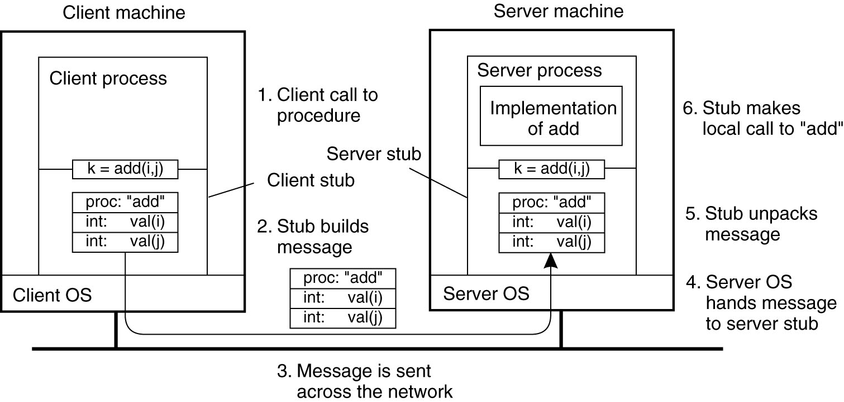
Passing Value Parameters
Figure 4-7. The steps involved in a doing a remote computation through RPC.

Slide 48
Issues
Are parameters call-by-value or call-by-reference?
Call-by-value: in same-process procedure calls, parameter value is pushed on the stack, acts like a local variable
Call-by-reference: in same-process calls, a pointer to the parameter is pushed on the stack
How is the data represented?
What protocols are used?

Slide 49
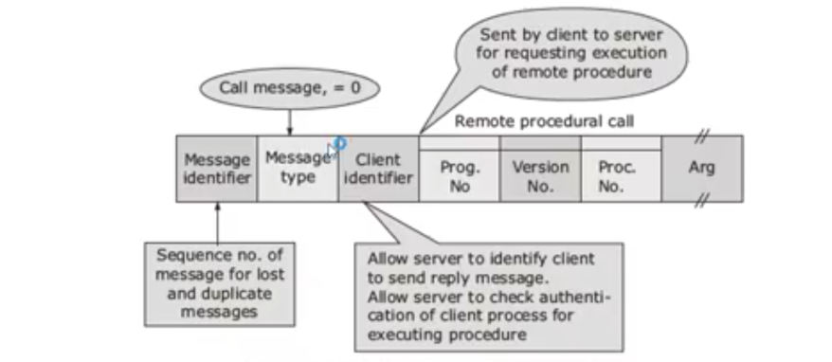
RPC Call/Request message

Slide 50
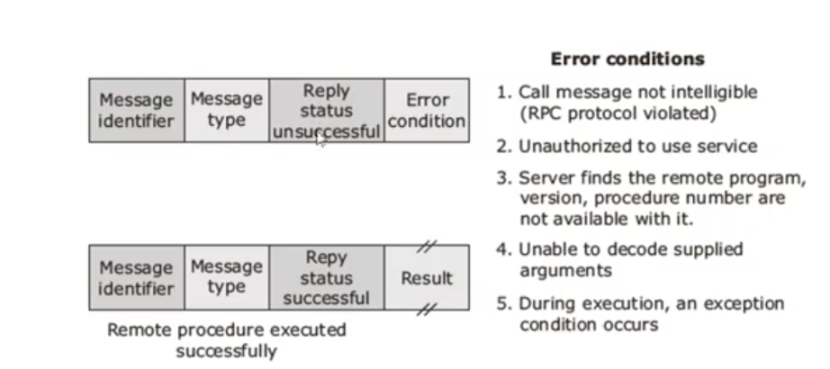
RPC Reply message

Slide 51
Parameter Passing –Value Parameters
For value parameters, value can be placed in the message and delivered directly, except …
Are the same internal representations used on both machines? (char. code, numeric rep.)
Is the representation big endian, or little endian?

Slide 52
Parameter Passing – Reference Parameters
Consider passing an array in the normal way:
The array is passed as a pointer
The function uses the pointer to directly modify the array values in the caller’s space
Pointers = machine addresses; not relevant on a remote machine
Solution: copy array values into the message; store values in the server stub, server processes as a normal reference parameter.

Slide 53
Other Issues
Client and server must also agree on other issues
Message format
Format of complex data structures
Transport protocol (TCP/IP or UDP?)

Slide 54
Reliable versus Unreliable RPC
If RPC is built on a reliable transport protocol (e.g., TCP) it will behave more like a true procedure call.
On the other hand, programmers may want a faster, connectionless protocol (e.g., UDP) or the client/server system may be on a LAN.
How does this affect returned results?

Slide 55
Asynchronous RPC
Allow client to continue execution as soon as the RPC is issued and acknowledged, but before work is completed
Appropriate for requests that don’t need replies, such as a print request, file delete, etc.
Also may be used if client simply wants to continue doing something else until a reply is received (improves performance)
What are the problems with unreliable, asynchronous RPC?

Slide 56
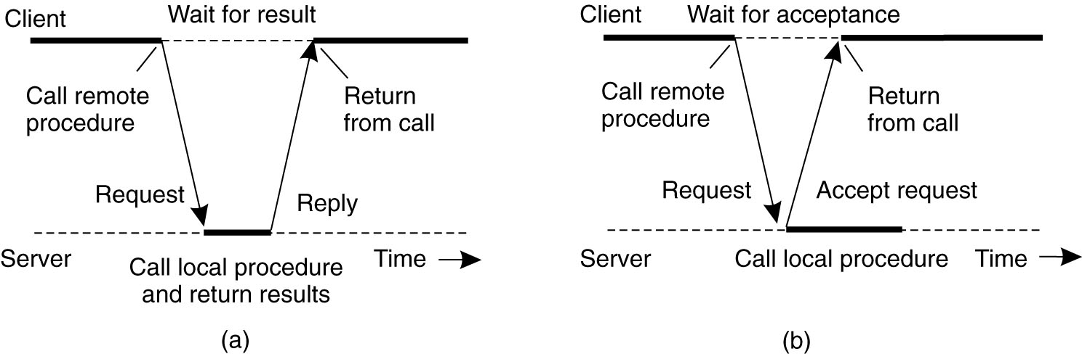
Synchronous RPC
Figure 4-10. (a) The interaction between client and server in a traditional RPC.

Slide 57
Asynchronous RPC
Figure 4-10. (b) The interaction using asynchronous RPC.

Slide 58
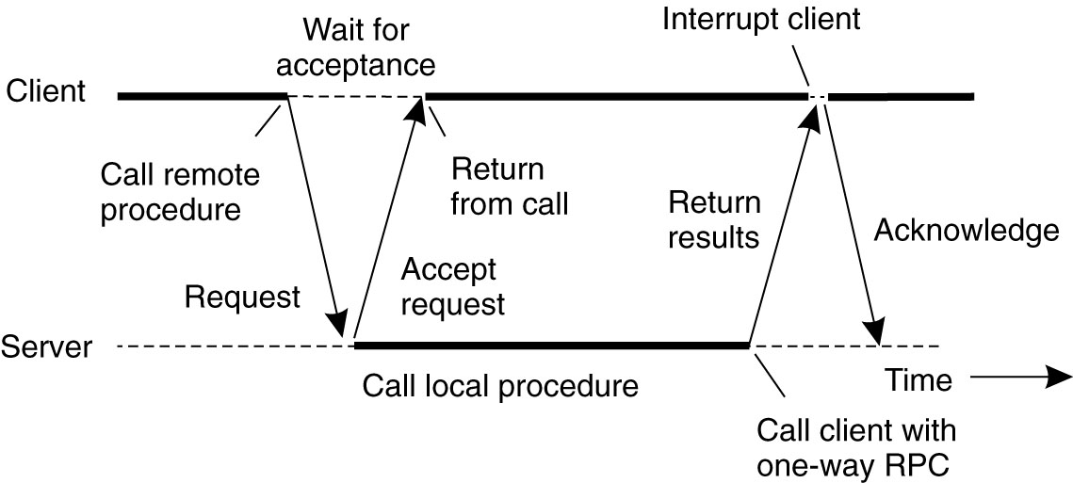
Asynchronous RPC
Figure 4-11. A client and server interacting through two asynchronous RPCs.

Slide 59
Synchronous or Asynchronous?
Figure 4-4. Viewing middleware as an intermediate (distributed) service in application-level communication.

Slide 60
Most Popular Implementations
DCE RPC: Distributed Computing Environment
Developed by the Open Software Foundation (OSF),
Adopted by Microsoft as its standard
Implemented as a true middleware system
Executes between existing operating systems and applications

Slide 61
Services Provided
Distributed file service: provides transparent access to any file in the system, on a worldwide basis
Directory service: keeps track of system resources (machines, printers, servers, etc.)
Security service: restricts resource access
Distributed time service: tries to keep all clocks in the system synchronized.

Slide 62
Sun Microsystems RPC
Also known as Open Network Computing (ONC) RPC – widely used, particularly on UNIX, Linux, and related operating systems.
The basic communication technique for NFS
Other vendors provide RPC products that implement the Sun protocols

Slide 63
Example
Pointer to notes showing how to create a simple C/S system to act as a date/time server using Sun RPC http://www.eng.auburn.edu/cse/classes/cse605/examples/rpc/stevens/SUNrpc.html
rpcgen is a compiler that generates client and server stubs (based on procedure specs)

Slide 64
rpcgen
rpcgen compiles source code written in the RPC Language and produces C language source modules, which are then compiled by a C compiler.
Default output:
A header file of definitions common to the server and the client
A set of XDR routines that translate each data type defined in the header file
A stub program for the server
A stub program for the client

Slide 65
RPC Issues: Binding
Binding: assigns a value to some attribute (address to identifier, for example.)
Sun RPC (ONC) runs a binding service at a specific port number on each computer (the port mapper)
Clients locate specific services by going through the port mapper. (Distributed Systems, Coulouris, et.al, p. 186)
DCE server machines run a daemon that keeps a table of <server, port #> pairs. The server must also register its network address with a directory service

Slide 66
RPC Summary
Supports a familiar paradigm (function calls)
Existing code can easily be adapted to run in a distributed environment
Makes most details (message passing, server binding) transparent

Slide 67
Remote Method Invocation (RMI)
Similar to RPC; allows a Java process running on one virtual machine to call a method of an object running on another virtual machine
Supports creation of distributed Java systems

Slide 68
Message Oriented Communication
RPC and RMI support access transparency, but aren’t always appropriate
Message-oriented communication is more flexible
Built on transport layer protocols.
Standardized interfaces to the transport layer include sockets (Berkeley UNIX) and XTI (X/Open Transport Interface), formerly known as TLI (AT&T model)
Notes:
RPC is usually synchronous, and is transient.

Slide 69
Sockets
A communication endpoint used by applications to write and read to/from the network.
Sockets provide a basic set of primitive operations
Sockets are an abstraction of the actual communication endpoint used by local OS
Socket address: IP# + port#
Notes:
Programmer doesn’t need to know the specific transport protocol; can use a standardized interface.

Slide 70
Primitive | Meaning
Socket | Create new communication end point
Bind | Attach a local address to a socket
Listen* | Willing to accept connections (non-blocking)
Accept | Block caller until connection request arrives
Connect | Actively attempt to establish a connection
Send | Send some data over the connection
Receive | Receive some data over the connection
Close | Release the connection
Notes:
Figure 4-14

Slide 71
How a Server Uses Sockets Internetworking with TCP/IP, Douglas E. Comer & David L. Stevens, Prentice Hall, 1996
System Calls
Socket
Bind
Listen
Accept
Read
Write
Close
Meaning
Create socket descriptor
Bind local IP address/ port # to the socket
Place in passive mode, set up request queue
Get the next message
Read data from the network
Write data to the network
Terminate connection
Repeat accept/close &
read/write cycles

Slide 72
How a Client Uses Sockets Internetworking with TCP/IP, Douglas E. Comer & David L. Stevens, Prentice Hall, 1996
System Calls
Socket
Connect
Write
Read
Close
Meaning
Create socket descriptor
Connect to a remote server
Write data to the network
Read data from the network
Terminate connection
Repeat read/write
cycle as needed

Slide 73
Socket Communication
Using sockets, clients and servers can set up a connection-oriented communication session.
Servers execute first four primitives (socket, bind, listen, accept) while clients execute socket and connect primitives)
Then the processing is client/write, server/read, server/write, client/read, all close connection.

Slide 74
Message-Passing Interface (MPI)
Sockets provide a low-level (send, receive) interface to wide-area (TCP/IP-based) networks
Distributed systems that run on high-speed networks in high-performance cluster systems need more advanced protocols
High-performance multicomputers (MPP) often had their own communication libraries.
A need to be hardware/platform independent eventually led to the development of the MPI standard for message passing.

Slide 75
MPI
Designed for parallel applications using transient communication
MPI is a library specification for message-passing, proposed as a standard by a committee of vendors, implementers, and users.
MPICH2 is a popular implementation
It is used in many environments, including both clusters and heterogeneous networks
Platform independent

Slide 76
Communication in MPI
Assumes communication is among a group of processes that know about each other
Assign groupID to group, processID to each process in a group
(groupID, processID) serves as an address

Slide 77
Message Primitives
MPI_bsend: asynchronous.
sender resumes execution as soon as the message is copied to a local buffer for later transmission (bsend = buffer send)
The message will be copied to a buffer on the receiver machine at a later time in response to a receive primitive.
Corresponds to our previous definition of asynchronous communication

Slide 78
Message Primitives 3 Levels of Blocking Sends
MPI_send: blocking send (block until message is copied to a local or remote buffer)
semantics are implementation dependent
MPI_ssend: Sender blocks until its request is accepted by the receiver
MPI_sendrecv: send message, wait for reply. (Essentially same as RPC)

Slide 79
MPI Apps versus C/S
Processes in an MPI-based parallel system act more like peers (or peer slaves to a master processor)
Communication may involve message exchange in multiple directions.
C/S communication is more structured.

Slide 80
Message-Oriented Middleware (MOMS) - Persistent
Processes communicate through message queues: sender appends to queue, receiver removes from queue
MPI and sockets support transient communication, message queuing allows messages to be stored temporarily (minutes versus milliseconds).
Neither the sender nor receiver needs to be on-line when the message is transmitted.
Designed for messages that take minutes to transmit.

Slide 81
Stream-Oriented Communication
RPC, RMI, message-oriented communication are based on the exchange of discrete messages
Timing might affect performance, but not correctness
In stream-oriented communication the message content must be delivered at a certain rate, as well as correctly.
e.g., music or video

Slide 82
Representation
Different representations for different types of data
ASCII or Unicode
JPEG or GIF
PCM (Pulse Code Modulation)
Continuous representation media: temporal relations between data are significant
Discrete representation media: not so much (text, still pictures, etc.)

Slide 83
Data Streams
Data stream = sequence of data items
Can apply to discrete, as well as continuous media
e.g. UNIX pipes or TCP/IP connections which are both byte oriented (discrete) streams
Audio and video require continuous data streams between file and device.

Slide 84
Data Streams
Asynchronous transmission mode: the order is important, and data is transmitted one after the other.
Synchronous transmission mode transmits each data unit with a guaranteed upper limit to the delay for each unit.
Isochronous transmission mode have a maximum and minimum delay.
Not too slow, but not too fast either

Slide 85
Streams
Simple streams have a single data sequence
Complex streams have several substreams, which must be synchronized with each other; for example a movie with
One video stream
Two audio streams (for stereo)
One stream with subtitles

Slide 86
Distributed System Support
Data compression, particularly for video
Quality of the transmission
Synchronization

Slide 87
Multicast Communication
Multicast: sending data to multiple receivers.
Network- and transport-layer protocols for multicast bogged down at the issue of setting up the communication paths to all receivers.
Peer-to-peer communication using structured overlays can use application-layer protocols to support multicast

Slide 88
Application-Level Multicasting
The overlay network is used to disseminate information to members
Two possible structures:
Tree: unique path between every pair of nodes
Mesh: multiple neighbors ensure multiple paths (more robust)

